Slide 1
Greening of the Planet: Global Challenges, Local Solutions
Yacouba Moumouni
Country: Niger
Denver Seminar on
February 25th, 2011

Slide 2
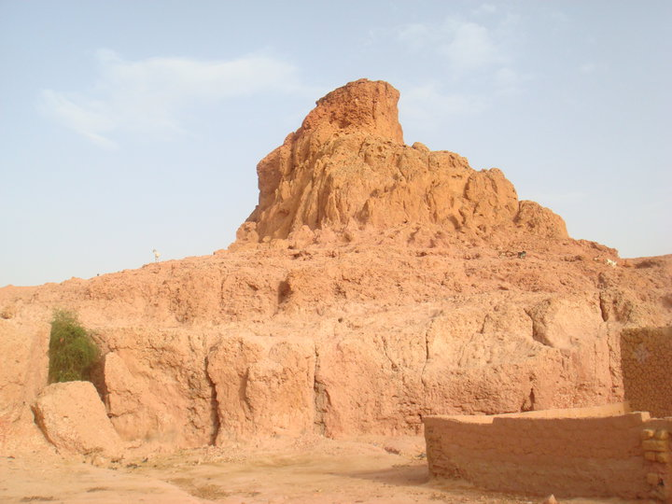
Technological Project For All-Doutchi

Slide 3
2/3 of Niger is desert
The Saharan Desert is a serious threat

Slide 4
IT IS COMING !
We come to an ultimate conclusion that it is better late that never.

Slide 5
Borassus aethiopium
Grow swelling
Solitary trunks
25 meters in height
1 m in diameter at the base
3 meter leaves
2 meter petioles armed with spines
Male plants-flower inconspicuous
Female plants-flower 2 cm
Latter produce yellow to brown fruits

Slide 6
Trees can grow in the Desert
Date tree
Date tree

Slide 7
The 3 aspects of the Project
General aspects
Specific aspect focuses on Env.
International Tournament of Volley ball
Technological Project for All
Computer
Internet
Professional re-orientation
Electricity
Efficient use of Energy
Plantation of Trees, i.e. Ron Palm trees. The scientific is Borassus aethiopium

Slide 8
Specific issue addressed is how to:
Stop the deforestation
Reverse the process
Create new jobs
Stop the mass rural exodus
Create hope in people’s mind
Make the land productive
Stop the advance of the desert
.

Slide 9
Why the specific aspect?
Niger has a mass of 1,267,000 km2
2/3 is desert
Desert is advancing at a faster rate
Trees cutting down to meet Energy demand
80% of population are farmers
Unproductive land
Annual rain fall more or less 400 mm
August is the rainiest month
Exodus is accentuated

Slide 10
What the PTPT is all about?
It was founded in July 2007 in Niamey
We’re three Engineers
Hosted by the International Tournament of VB
The intension was to rotate it
The intension is to propagate the NTICs
Globalization is our motto
Intend to break the knowledge barrier
computers business entrepreneurship

Slide 11
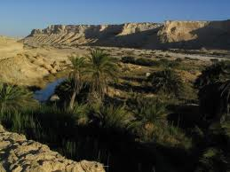

Slide 12
One of the first trainees, Barthez

Slide 13
Overview ( Continued )
The project Non-profit
Aim equity and equality for all
Promote the right and self-sufficiency
Proximity and continuous training
Specialists and influential guests are invited to present issues on:
Env.
Human right
Education, etc.

Slide 14
Our methods
Tournament is held in August
Efficient use of the man power
All activities stopped one afternoon
Plant plenty of trees
Diversify sites
Ron palm selected for:
Strength
Resistance to wind blow

Slide 15
Outcome and Impact
Long term is to stop the advance of the desert
Eastern part of Doutchi is becoming greener
Hope is created in farmers’ mind
Authorities are more than ever prepared for the moment
Perspective future jobs

Slide 16
FBT experience contribution
My skills are improving
Knowledge is power
Knowledge facilitates communications
I feel more professional than ever
Develop efficient use of Energy
Enables me to harness Solar E for their daily E needs rather than wood
It develops senses leadership

Slide 17
Conclusion
Sustainability
"...development that meets the needs of
the present without compromising the
ability of future generations to meet their
own needs." (Earth Summit,1992)
Most of the time used to describe
environmental quality and at times
economic conditions.
What’s been done at local level so far?

Slide 18
Thanks for your attention
QUESTIONS?

