Slide 1
Bifacial Photovoltaic modules
By: Jazmine Boloor

Slide 2
Bifacial photovoltaic modules: Agenda
General overview of bifacial solar panels
How do bifacial solar panels work?
How should bifacial solar panels be placed?
How do bifacial solar panels compare to monofacial solar panels?
How do bifacial solar panels perform?
Image Reference: [5]

Slide 3
general overview
Bifacial photovoltaic modules are solar power innovations that utilize both sides of their structure to produce energy, meaning they can create more solar power.
Until recently, most bifacial solar panel options have been large scale commercial ones.
Bifacial panels have been on market for around a decade.
They are not a new concept, but there is renewed interest in them recently due to advancements in cell fabrication and performance enhancements.
It is predicted that the market will increase by a factor of ten in the next four years.
The cost of bifacial solar panels is now competitive to the industry standard (which is monofacial solar panels).
Major bifacial solar panel makers: Amerisolar, Silfab Solar, Sunpreme
References: [6], [3], [4]

Slide 4
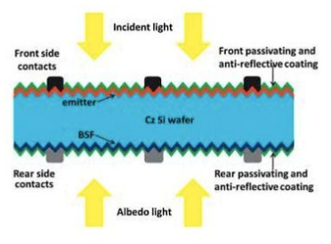
How do bifacial solar panels work?
Bifacial solar panels transform sunlight into electrical energy through both sides their structure – there are solar cells on top and bottom panels.
Both light striking their front panels as well as light incident on their rear side after reflection from objects/surfaces around it can create energy
Top layer faces sunlight to absorb its rays just like typical solar panel, but the bottom layer absorbs sunlight reflected from surrounding surfaces
Sunlight reflects off of objects at different angles, meaning this can produce a considerable amount of energy even on a cloudy day
Large amount of ground reflected radiation
References: [3], [4], [5] : ; Image Reference: [6]

Slide 5
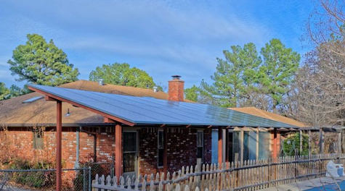
How should bifacial panels be placed?
Modules can be placed at an angle with space beside so sunlight can reflect on bottom
Applications such as patio and parking lot covers; anything that can be tilted
Modules can be placed so that one side of the bifacials in an array can face east to capture sunrise rays; the other half can face west to capture sunset rays.
Two peak times – sunrise and sunset
Modules could be placed vertically (standing up) with the same peak times
Advantage is that bad weather won’t block its functioning.
References: [1], [3], [6]; Image Reference: [6]

Slide 6
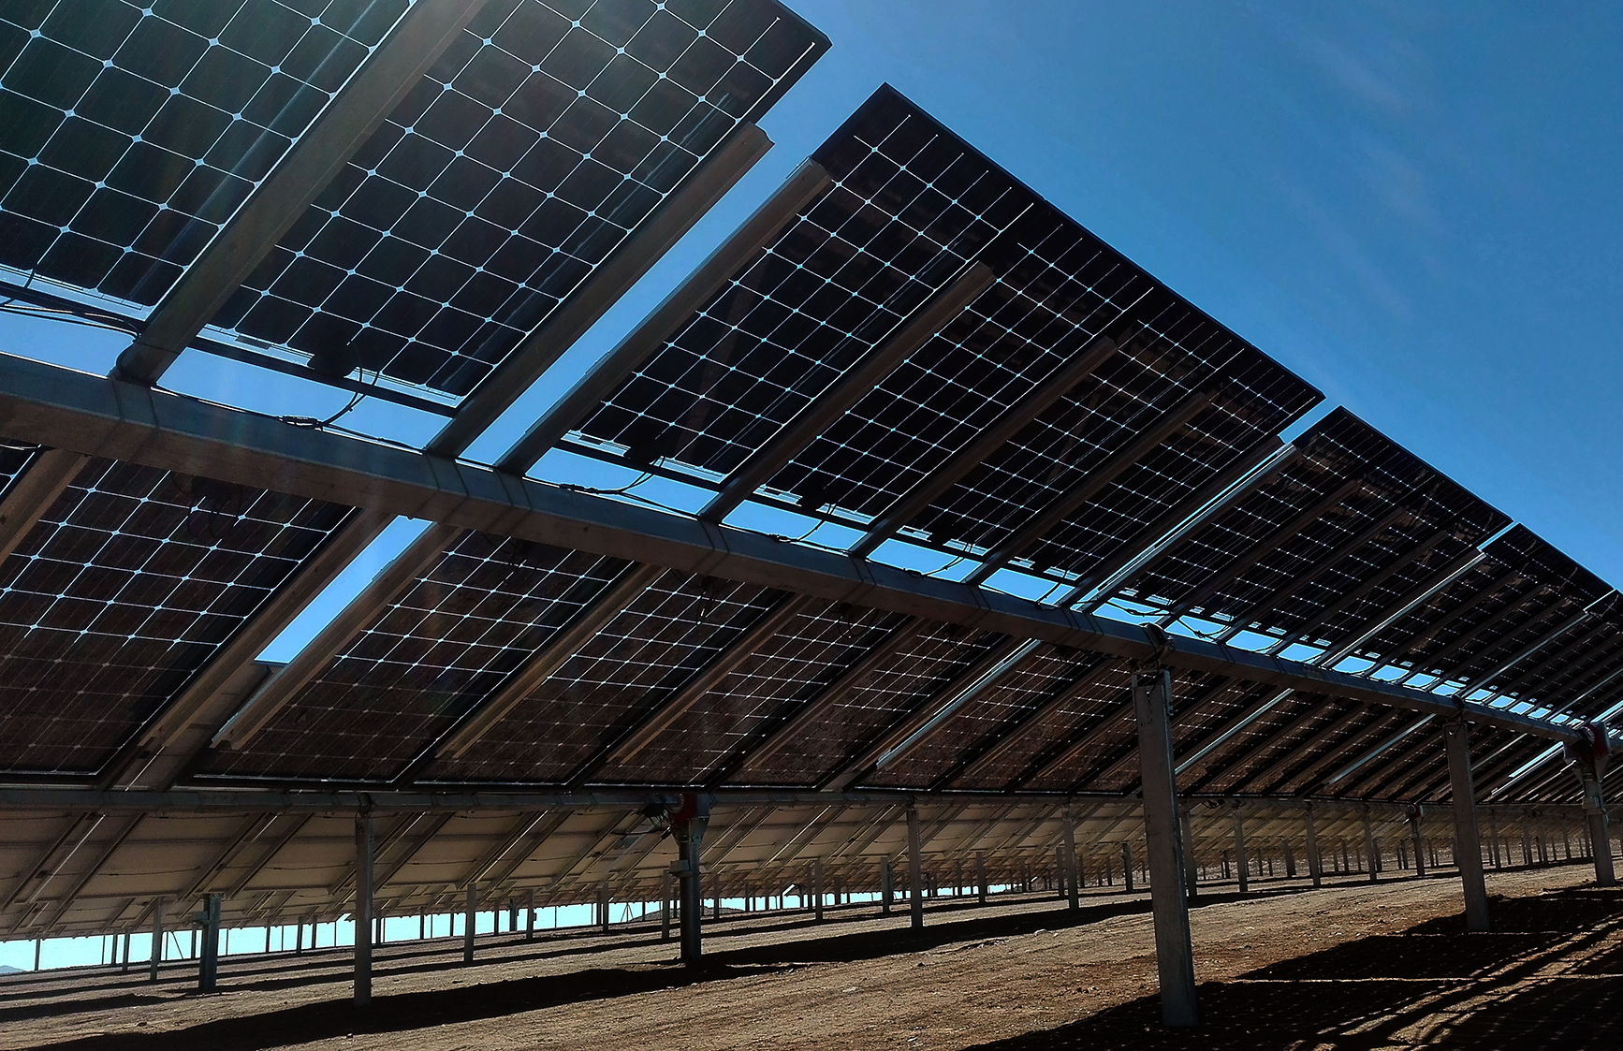
How do bifacial solar panels compare to monofacial solar panels?
Can increase efficiency by 11% to 27%
Fewer panels are necessary for the same amount of solar energy production
Maximum efficiency for small spaces
Limited research due to currently small market (though projected to grow)
References: [2], [6]; Image Reference: [6]

Slide 7
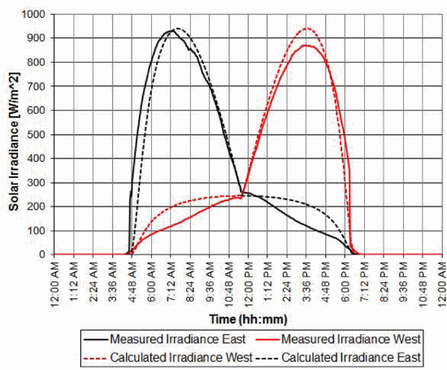
How do bifacial PV modules perform?
There was a study conducted in 2012 by IEEE that modeled the behavior of the Sanyo bifacial PV modules (Model # HIP-195DA3).
No previous information was known about the energy production of the back side of the panel other than a general rating
The power-voltage curve under a solar irradiance of 950 W/m² was measured (at 135˚F) and concluded that the back side of the panel was around 15% less efficient than the front side
The Solar Irradiance over time was measured; the two peak sunlight hours are clear on the plot to the right.
S_{total} = S_{array} + S_{diffuse} + S_{reflect} where S_{array} is the direct-beam radiation, S_{diffuse} is the diffuse radiation, and S_{reflect.}
Clearly, a panel with shading/less sun would get less direct beam radiation and more reflected radiation (shown in red)
References: [1], [3], [6]; Image Reference: [3]

Slide 8
How do bifacial PV modules perform (cont.)
In the same IEEE study, the east facing modules experienced up to four centimeters of shading across their panels throughout hours of the day
The photo on the right shows the shading (caused by the metal bar on the structural foundation).
Shading can decrease energy production significantly, and this consequence is directly seen on the plot on the previous slide.
This is part of the reason that the east facing panel does not match calculated values
References: [3]; Image Reference: [3]

Slide 9
References
[1]
[2]
[3]
Gambone, S. (n.d.). What Are Bifacial Solar Panels. Retrieved November 18, 2020, from https://www.paradisesolarenergy.com/blog/what-are-bifacial-solar-panels
Garner, R. (2015, April 03). Solar Irradiance. Retrieved November 18, 2020, from https://www.nasa.gov/mission_pages/sdo/science/solar-irradiance.html
Johnson, J., Yoon, D., & Baghzouz, Y. (2012). Modeling and analysis of a bifacial grid-connected photovoltaic system. 2012 IEEE Power and Energy Society General Meeting. doi:10.1109/pesgm.2012.6345266
Marion, B., MacAlpine, S., & Deline, C. (2017, June 25). A Practical Irradiance Model for Bifacial PV Modules. Retrieved November 18, 2020, from https://www.nrel.gov/docs/fy17osti/67847.pdf
Pickerel, K. (2019, April 09). What are bifacial solar modules and how do they work? Retrieved November 15, 2020, from https://www.solarpowerworldonline.com/2018/04/what-are-bifacial- solar-modules/
SolarMag. (2020, March 01). Bifacial Solar Panels: Residential Uses and Trends. Retrieved November 10-20, 2020, from https://solarmagazine.com/solar-panels/bifacial-solar-panels/
[4]
[5]
[6]

