Slide 1
AVRT
Atrial ventricular Reentrant tachycardia
Jazmine Boloor

Slide 2
PATIENT IN AVRT: EKG
DELTA WAVE:
SA node triggers, sends signal to AV node and accessory pathway
AV node has a safeguard to slow the signal down so the ventricles can fill. Accessory pathway doesn’t have safeguard, meaning the signal can very quickly travel from the atria down, depolarizing the ventricles. This creates a slurred upstroke, as the P wave is closely coupled with the QRS. Once the signal gets through the AV node, it travels very quickly through the circuit of the heart and up the accessory pathway, creating a sharp downwards wave as the ventricles depolarize.
Notes:
Tachycardia or SR?

Slide 3
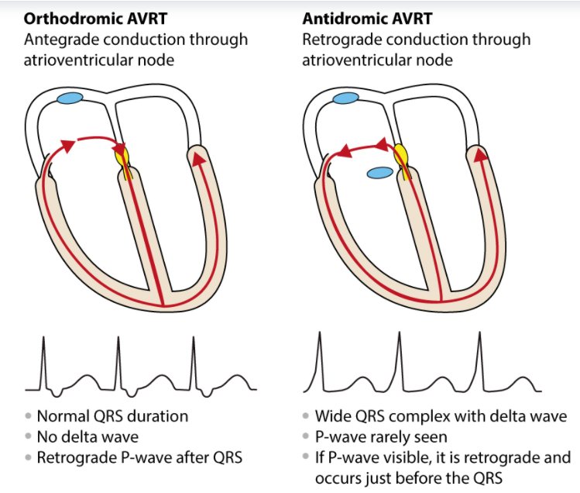
PATIENT IN AVRT: EKG (CONT)
Circuit:
Orthodromic: from atria, down AV node to ventricles, up accessory pathway
Antegrade
Manifest pathway or concealed pathway
Antidromic: from atria, down accessory pathway to ventricles, up AV Node
Retrograde
Delta wave
Manifest pathway

Slide 4
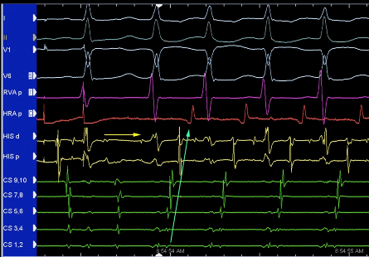
PATIENT IN AVRT: EMG
Usually induced by programmed stimulation
If not already in tachycardia
Wenckebach, effective refractory periods
We would probably see that the AV node is decrementing; if not the signal is probably taking an accessory path
Mapping:
Pace the ventricles, map the atrium for earliest signal
Manifest or concealed pathway
Pace the atria, map the ventricles for earliest signal
Manifest pathway - Antidromic
Notes:
Is the patient already in tachycardia, we might see eccentric activation like shown In this picture. Going from CS 1 to 10. since starts at 1, probably in the left side

Slide 5
DIAGNOSING THE PATIENT
Going through some scenarios:
If there is a delta wave (pre – excitation) – probably antidromic AVRT, manifest pathway
If no delta wave and patient is only going into tachycardia when pacing in the ventricles – probably orthodromic AVRT, concealed pathway
If there is no delta wave and the patient is going into tachycardia both when pacing in the ventricles and when pacing in the atria – probably orthodromic AVRT, manifest pathway
FINAL DIAGNOSIS FOR ABLATION: The patient goes into tachycardia when pacing both the atria and the ventricles; eccentric activation seen on the CS catheter. This patient is in orthodromic AVRT and has a manifest pathway on the left side of the heart near where CS 1,2 are.

Slide 6
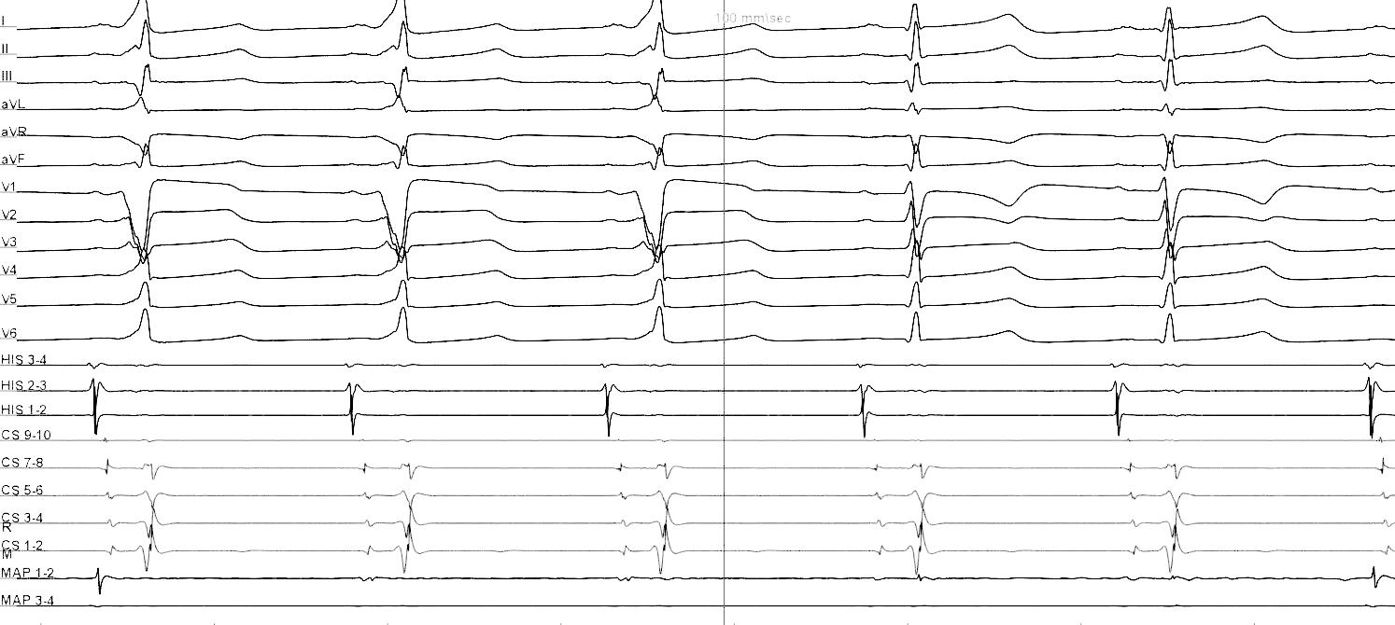
ABLATION
Ablate the accessory pathway
Manifest Pathway:
Could ablate while in sinus rhythm so the loss of the delta wave can be seen (if there is one)
Concentric activation on CS
Decremental properties with programmed stimulation (AV node will be conducting the signal)
Concealed Pathway:
Concentric activation on CS (ventricular pacing only)
Decremental properties with programmed stimulation (AV node will be conducting the signal)
*Showing the loss of a delta wave after a successful ablation

Slide 7
Thank you!

