Slide 1
Final Laboratory: PWM Frequency Regulated AC/DC Rotary Convertor
Machine Construction, Interface/Integration, Controls, Filter and Design
By: Octavio Gonzalez, Tone Pondaharn, Dane Gentry, and Clinton Bess

Slide 2
Description
This project consists of the design of a simplified DC to AC Converter.
Prime mover driven by microcontroller amplifier section.
Correct PWM (Pulse Width Modulation) control scheme.
AC generator section is comprised of a two pole single phase winding with 56 turns per coil and 6 coil groups wound at #24AWG.
Control of the rotary field is accomplished by sampling the generator RMS terminal voltage and adjusting the DC duty cycle to maintain frequency as it relates to output voltage.
The prime mover is rated at 8.2^{VDC} at 0.25^{ADC} and the generator is rated at 200^{mV} RMS.

Slide 3
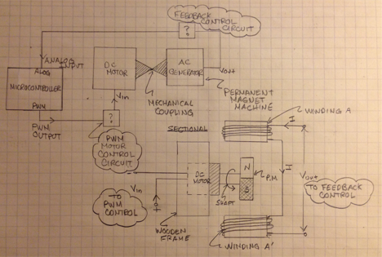
Block Diagram

Slide 4
Engineering Roles
Dane Gentry- Electronic solid state design and controls engineer.
Led Electronics Design
Semi-Conductor Application
Motor Protection and Isolation
PWM Amplifier Circuit
Supported Design Revisions and Design Verification
Wheatstone Bridge Rectifier (Output)
Integration Modifications (Toggle Switch)
Waveform Ripple/Smoothing Section
Testing/Troubleshooting
Illustrated Graphics
Altium Schematic and Footprint
CWD - Connection Wiring Diagram
Textbook References
Clinton Bess- Microcontroller programing and feedback controls engineer.
Led Feedback Controls Design
PWM Control
C Code Implementation
Conditional Checks
Set-point Definition
Supported Preliminary Design Phases
Algorithms
Pseudo-Rectification
Sampling Technique (RMS)
Implemented and Verified the Design
Testing
Integration Modifications
Waveform Analysis
Debugging/Troubleshooting
Validated the Design
Terminal Display/ HMI Meter

Slide 5
Engineering Roles
Tone Pondaharn- Microcontroller application and integration engineer
Led Microcontroller Integration and Design
Specifications and Operating Modes
Scaling Factor/Proportionality Constants
Registers, Pins, Functionality
Assembly and C Constraints
Supported Design Revisions and Design Verification
Arduino Function Tests (PWM)
Integration Modifications
Waveform Analysis (PWM and ALOG)
Specified Pin Schedule Assignments and Input/Output Hardware
Reference Voltage, Scaling, Terminal/HMI
Illustrated Diagrams
Altium PCB Footprint and Schematic
Octavio L. Gonzalez- Electro-mechanical machine construction/design and test engineer.
Led Conceptual Design
Relevancy and Purpose
Identified Key Design Objectives
Methods
Supported Preliminary Design Phases
Feasibility
Calculations
Implemented and Verified the Design
Realization
Integration Modifications
Waveform Analysis
Troubleshooting
Validated the Design
Reviewed that the Design meets the Requirements
Organized Presentation Materials and PowerPoint

Slide 6
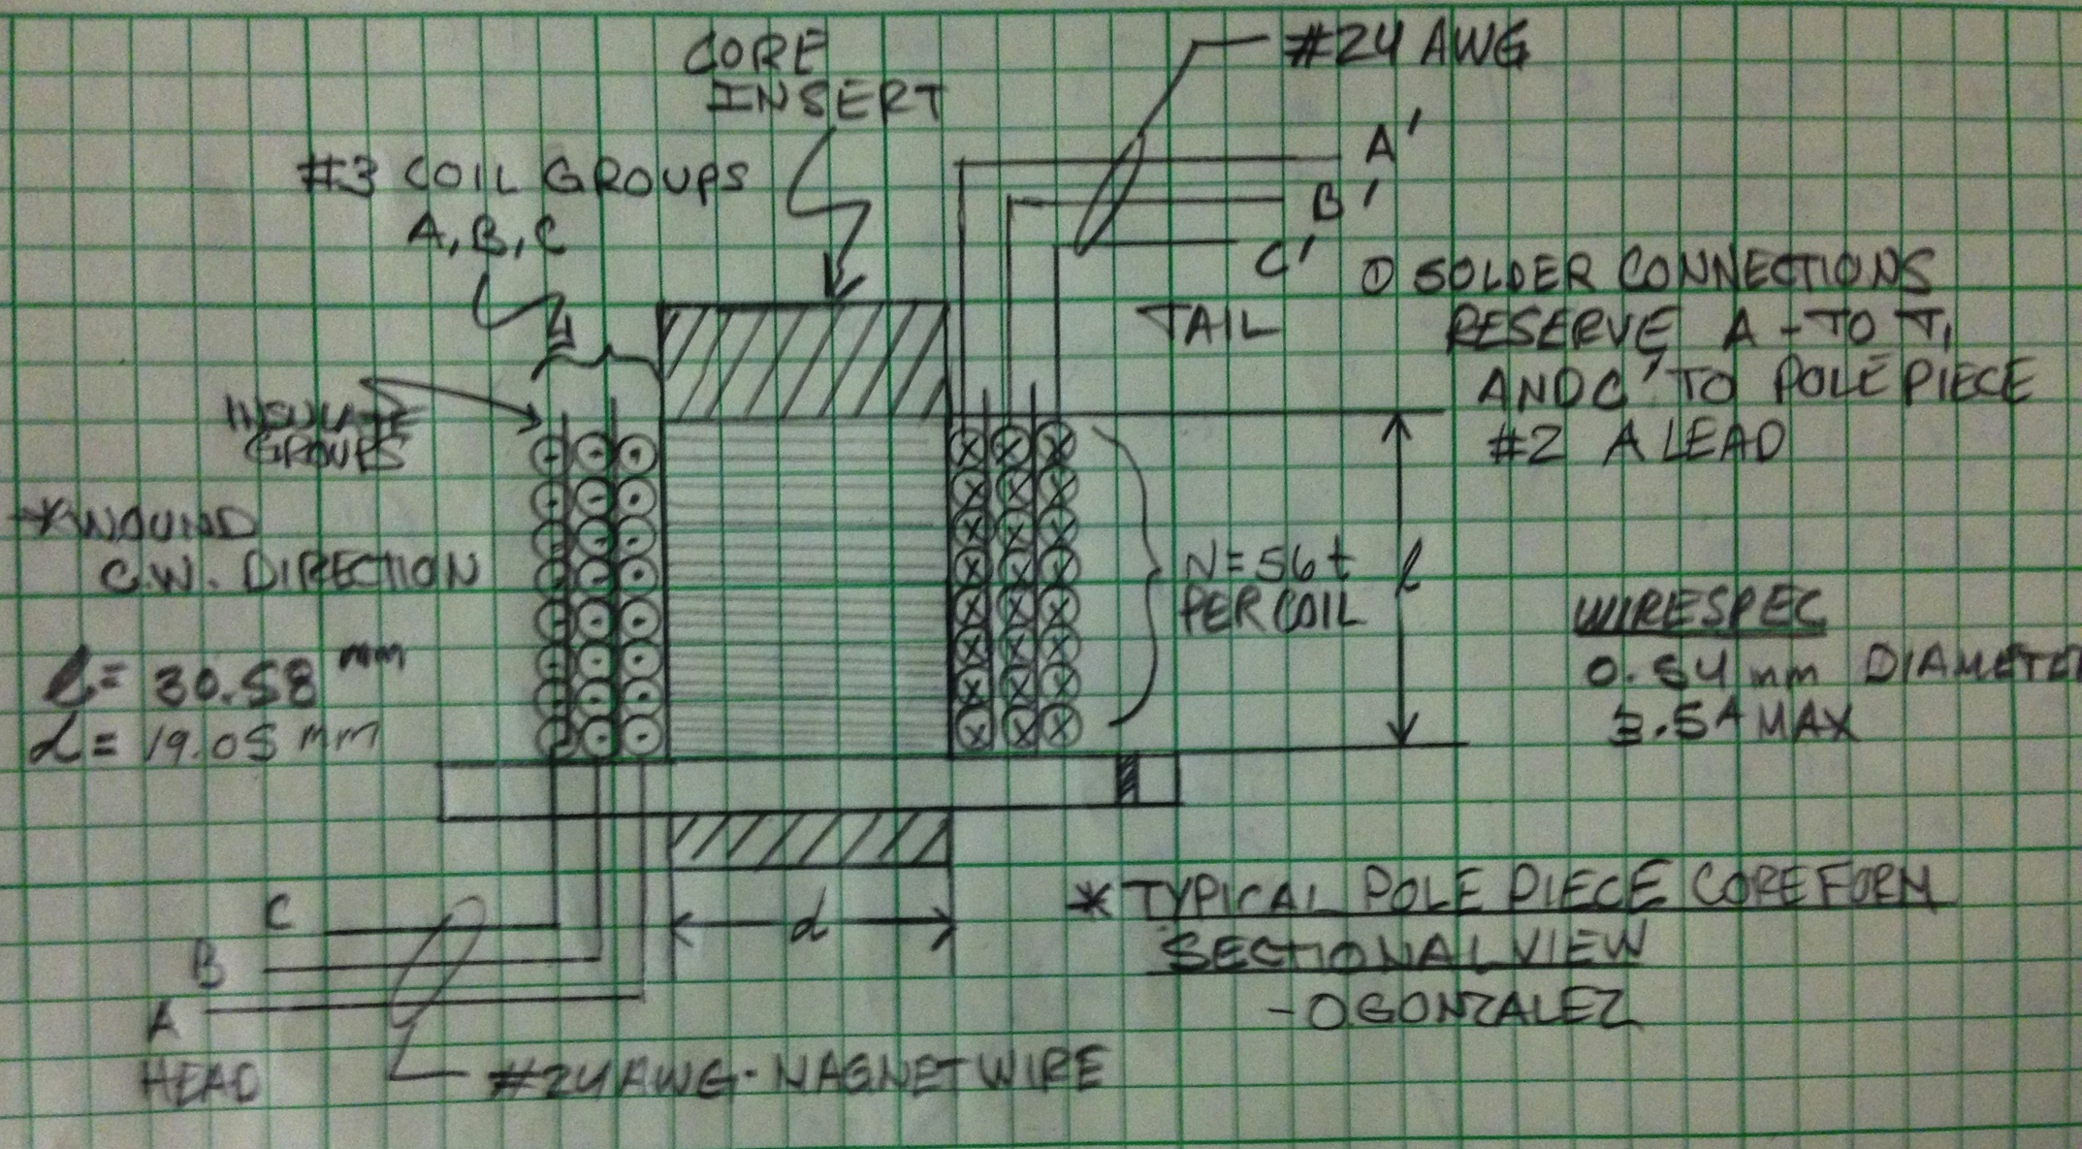
AC Generator Section Winding and Construction

Slide 7
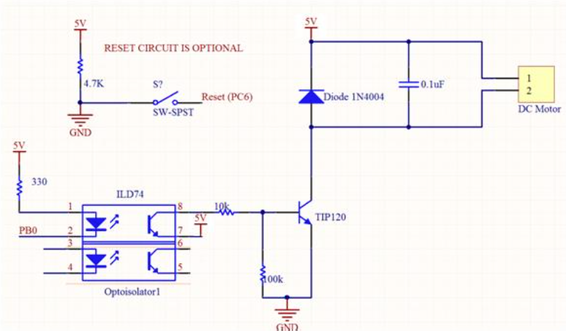
Power Circuit

Slide 8
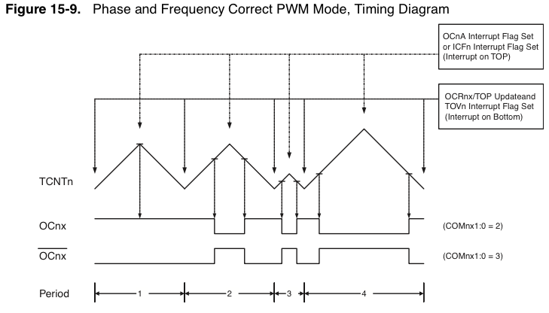
Pulse Width Modulation Theory

Slide 9
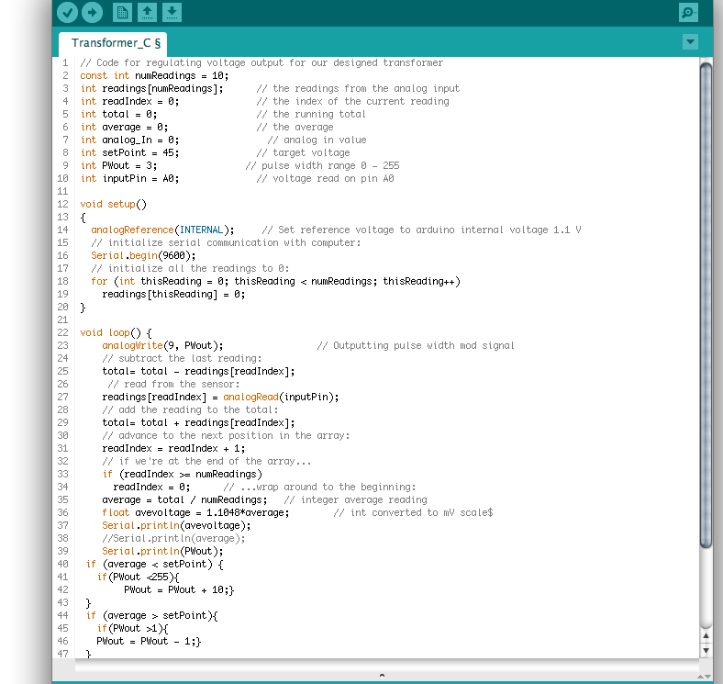
Voltage Regulation Code

Slide 10
Problems Encountered
Weak Flux Linkage and High Magnetic Reluctance Path.
Analog-In Read and Time Varying Signal Sampling/Averaging.
DC Motor Failure.
Harmonics (3rd)! Distorted MMF.
PWM Code and Speed Regulation Over Full Voltage Range.
Timing and Generator Prime Mover Response.
Voltage Regulation. Full-Load Vs. No Load.

Slide 11
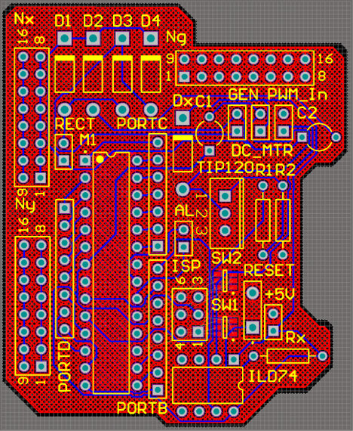
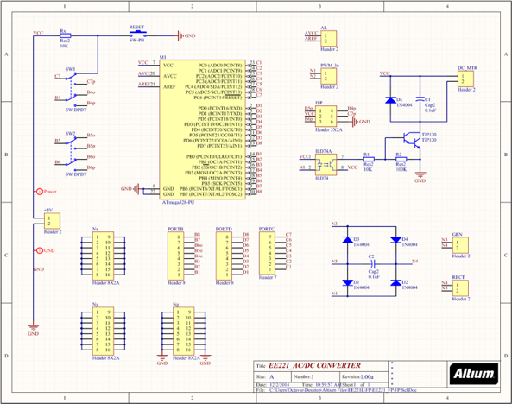
Additional Information
Altium: PCB Implementation
Theoretical Implementation of Automatic Voltage Regulator
Altium: Schematic

Slide 12
Conclusion
Electromagnetic Induction Principles.
Analog Steady State Measurements, RMS, and Sampling.
Electronics, Filter, Bridge and Amplifier design.
Microcontroller Interfacing and Interconnection.
Programming/CS Requirements.
Soldering and Hands-on Problem Solving.
Cross-Discipline Teamwork with EE221 Emphasis.
Q/A?

Slide 13
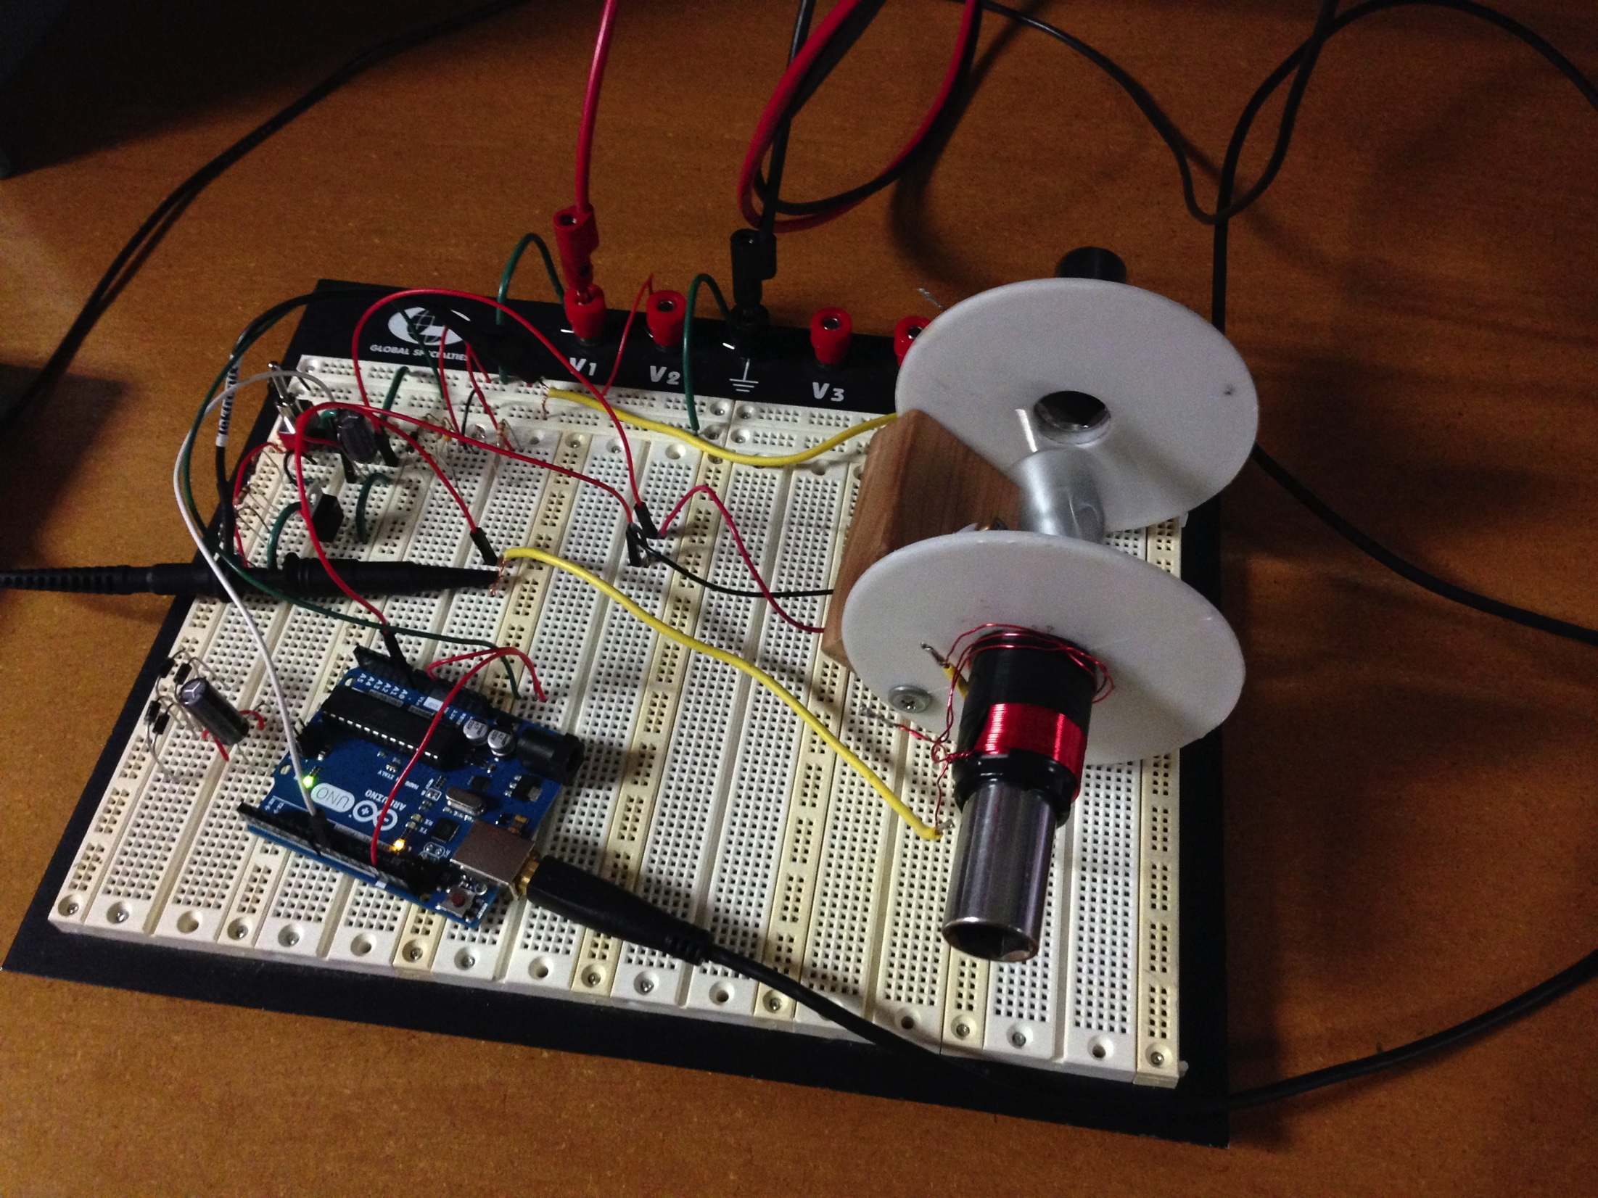
Demonstration

