Slide 1
Digital Pad Operation
Christian Vega
R. Jacob Baker
UNLV Electrical & Computer Engineering

Slide 2
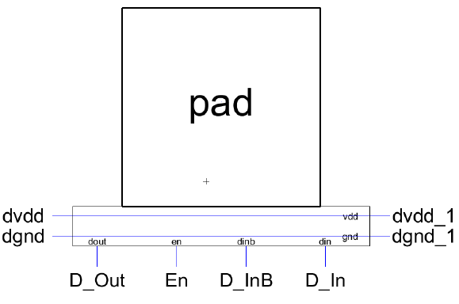
Digital I/O Pad
The digital I/O pad can be used for receiving data (input, sending data to circuitry on the chip) and transmitting data (output, sending data off chip)
D_Out is the connection for transmitting data out of the chip
En is the control connection; En = 1 puts the pad in transmitting mode, D_out is used while D_In and D_InB (complement of D_In) follow D_out and its complement respectively
En = 0 the pad is in the receive mode
En = 0 D_Out is a don’t care
D_In and D_InB are the true/complement inputs
The pad also contains electrostatic discharge (ESD) diodes for protection from over voltages

Slide 3
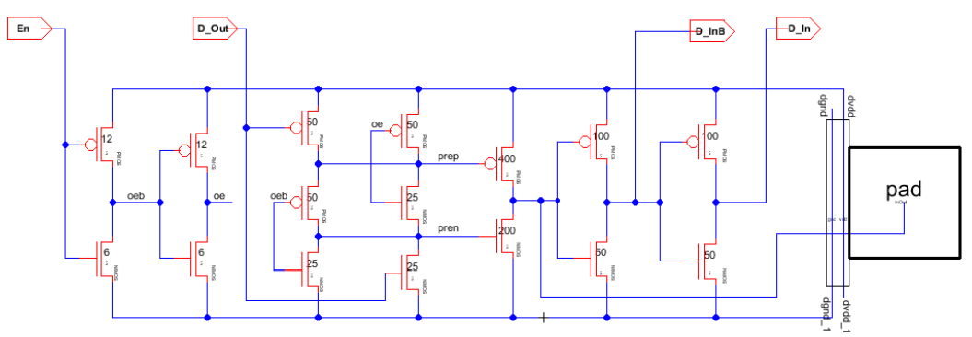
Bidirectional Circuit
The bidirectional circuit can be used to send signals off chip, to drive heavy loads, and for receiving signals, providing true and complement inputs
The general schematic of the IO pad circuitry is seen below

Slide 4
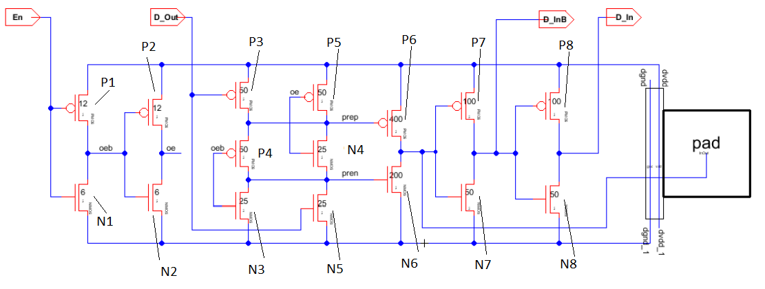
Naming Convention
For this tutorial we are using a the naming seen below

Slide 5
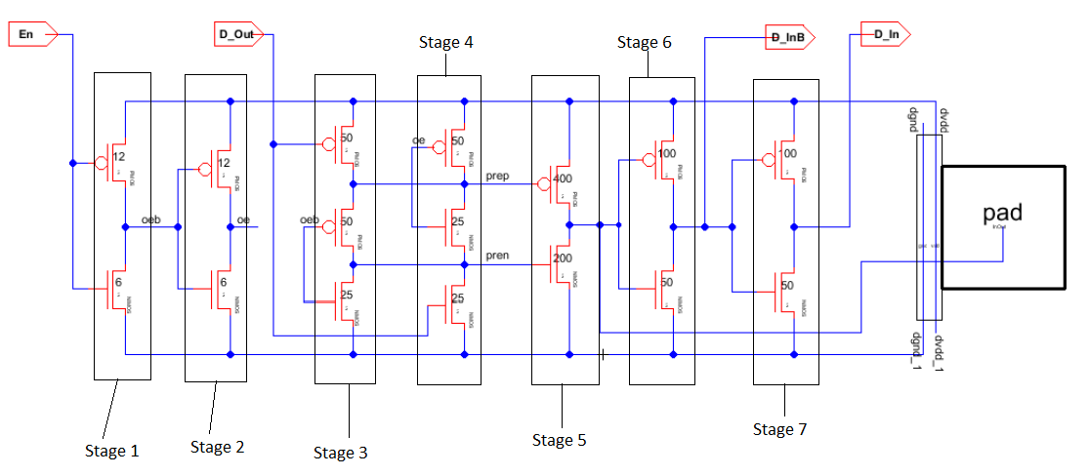
Naming Convention
We will also divide the circuit into 8 stages to simplify the explanation shown below
As a note for the following explanation VDD corresponds to logic 1 and ground or GND corresponds to logic 0

Slide 6
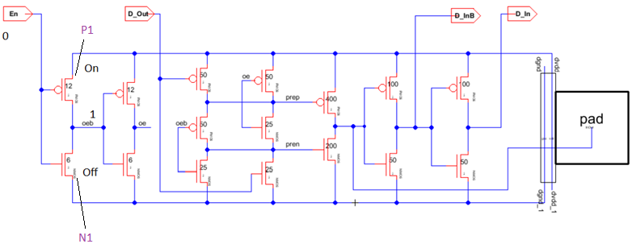
Driving A Signal On-Chip
Let us set the enable (En) port to a logic 0 (ground), notice that in the first inverter stage MOSFET P1 is on and N1 is off so the value that passes through the node “oeb” is logic 1 due to that node being pulled up to VDD

Slide 7
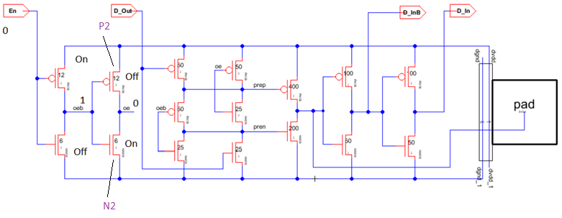
Driving A Signal On-Chip
Now for the second stage P2 is off and N2 is on so node “oe” is pulled down to ground (0)

Slide 8
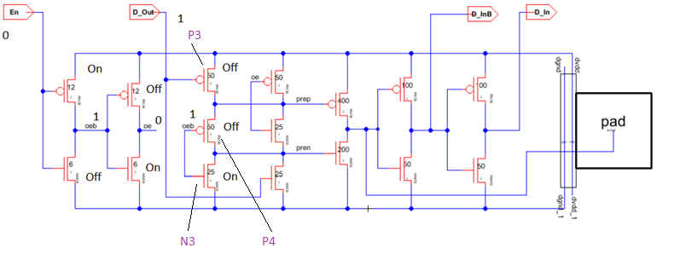
Driving A Signal On-Chip
Stages 3 and 4 get a little tricky to explain because the port D_out is introduced, so for the sake of the explanation we will set it to logic 1
With that P3 is turned off, P4 is turned off because its gate is tied to node “oeb” which is currently at 1
N3 is turned on because its gate is also tied to node “oeb”

Slide 9
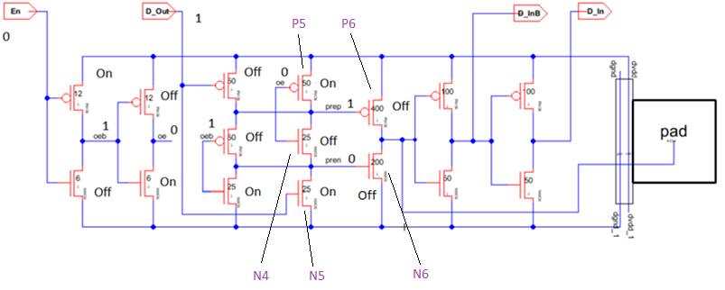
Driving A Signal On-Chip
For stage 4 the gates of P5 and N4 are tied to node “oe” which is set to 0 so P5 is turned on and N4 is turned off
N5’s gate is tied to D_Out so it is set to 1 turning N5 on as a result, the nodes label “prep” is set to 1 and “pren” is set to 0
So due to this N6 and P6 are turned off

Slide 10
Driving A Signal On-Chip
Now lets pause for a moment in order to evaluate the current operation the circuit is going under
Setting the enable pin to 0 leads to stage 5 turning completely off (N6 and P6 are off)
So the first 5 stages are cut off from the last two and the pad
This is so a signal can be applied to the pin connected to the pad from the outside (so the pin is used as an input)
If you noticed what you apply to D_Out does not matter because it will not pass through the 5th stage
D_Out is used when you want to use the pad as an output to drive a load

Slide 11
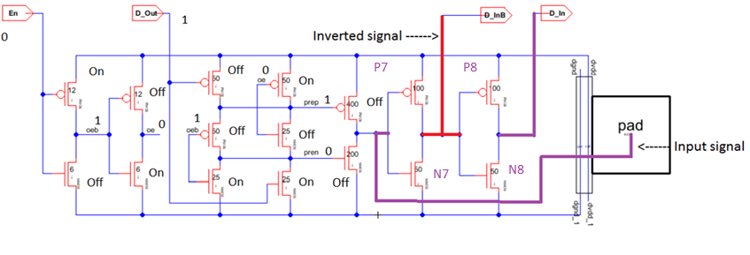
Driving A Signal On-Chip
With the previous in mind lets apply an arbitrary digital signal to the pad
The signal will pass to the 6th stage which consists of an inverter that simply inverts the signal which goes to the port D_InB which is then supplied to the chip
The now inverted signal is passed to stage 7 which is another inverter that supplies the original signal to the chip (port D_In)

Slide 12
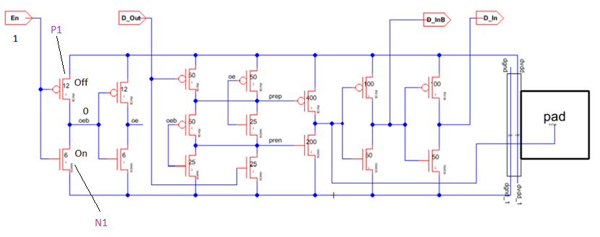
Driving A Signal Off-Chip
Lets now say that the chip generates a signal that needs to be sent out to drive a load, so lets set the enable (En) port to 1
In stage 1 P1 is shut off and N1 is turned on so node “oeb” is pulled down to 0

Slide 13
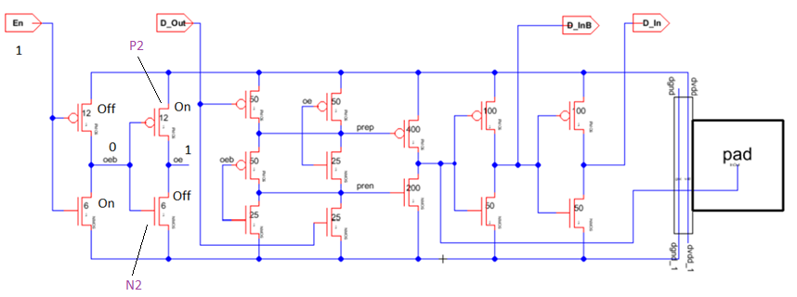
Driving A Signal Off-Chip
So 0 passes to the next stage turning P2 on and N2 off
Node “oe” is set to 1

Slide 14
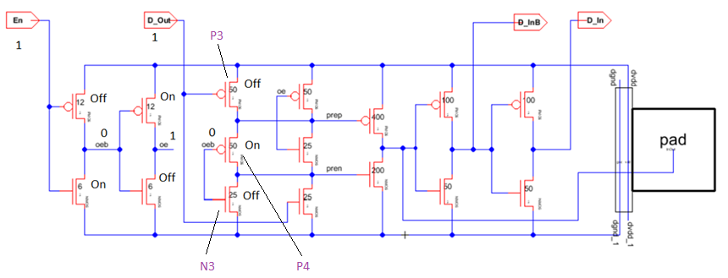
Driving A Signal Off-Chip
Now we are at the 3rd and 4th stage where D_Out is applied, lets say it is 1
P3 is turned off, while node “oeb” is at 0 so P4 is on and N3 is off

Slide 15
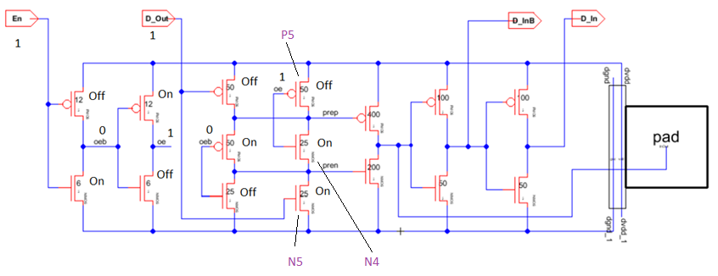
Driving A Signal Off-Chip
For the next stage node “oe” as can be seen from earlier is currently at 1 so P4 is off while N4 is on
The gate of N5 is tied to D_Out which is currently set to 1 so it is turned on

Slide 16
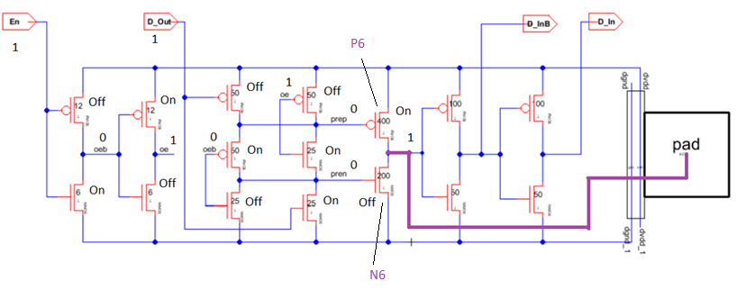
Driving A Signal Off-Chip
For the 5th stage both nodes “prep” and “pren” are pulled down to 0 so P6 is on and N6 is off so what goes to the pad is 1 which is the value of D_Out
The last two stages should not have an effect on this operation

Slide 17
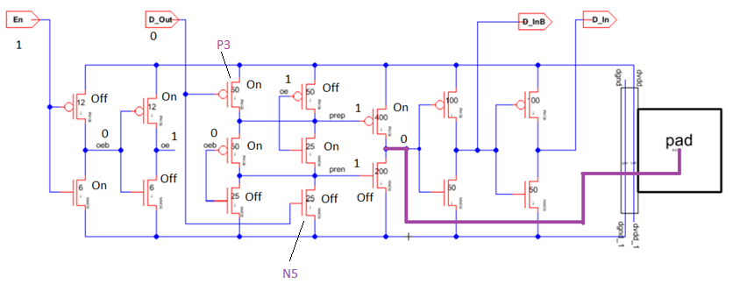
Driving A Signal Off-Chip
Lets take a moment to look at what happens if D_Out is set to 0
Nothing really changes except that P3 turns on and N5 turns off so the nodes “prep” and “pren” are pulled up to VDD (1)
That value goes to the 6th stage and is inverted to a 0 which is the value of D_Out and that goes to the pad

Slide 18
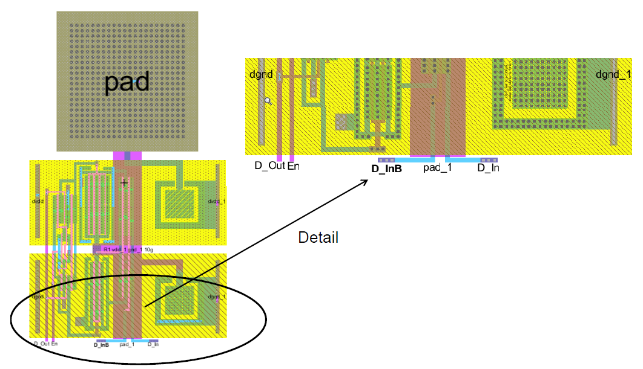
Background Information
Now that we have in detailed gone over the digital pad operation let us look at an actual layout of a digital pad on a real IC
Layout with a close up of part of the bidirectional circuit

Slide 19
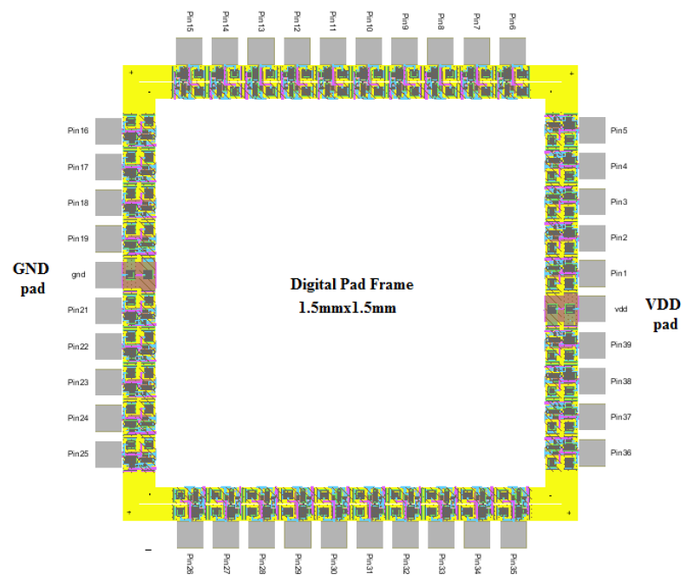
Background Information
40 pin quad frame layout

